Slide 1

Ruby on Rails

Slide 2
About today…
Ruby on Rails
Models
Database Migration

Slide 3
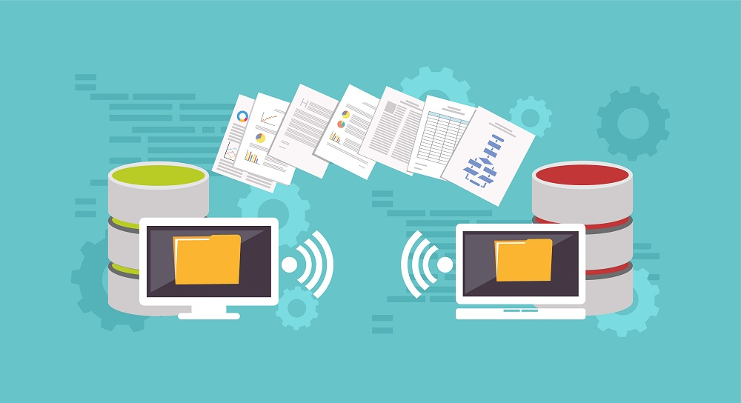
Models and Database Migration

Slide 4

Why Application Works Without a Model
If application only displays static content or handles data that doesn't need to be persisted in a database, we don't need a model
Application can work with just controllers and views to handle and display information

Slide 5
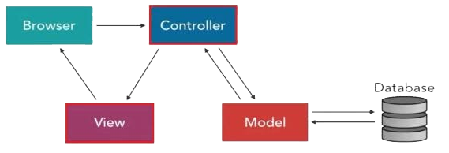
Purpose of Model
Model is a central component in Rails applications for handling the business logic and data persistence.
It represents the data of your application and the rules to manipulate that data

Slide 6
Working of Model
Interact with the Database
Interact with the database to perform CRUD (Create, Read,
Update, Delete) operations
ActiveRecord is the default ORM (Object-Relational Mapping) library used in Rails.
It provides an interface for models to interact with the database
ORM is a programming technique used to convert data between incompatible systems
Validations
Ensure data integrity by validating data before saving it to the database
Associations
Define relationships between different models (e.g., one-to-many, many-to-many)
Business Logic
Encapsulate the business rules that apply to your data

Slide 7
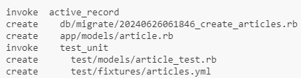
Creating a Model and Migration
When you create a model using the Rails generator

Slide 8
Creating a Model and Migration
Rails generates:
A model file (app/models/article.rb)
You don't need to write anything specific. Instead this empty model class has all the functionality needed to interact with the database, such as querying and saving records
A migration file (db/migrate/xxxxxxxxxxxxxx_create_articles.rb)
The migration file contains the instructions to create the corresponding table in the database with the specified fields

Slide 9

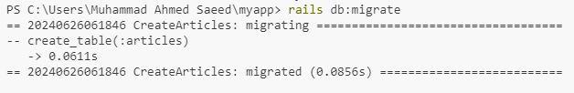
Database Migration
In order to actually create the table, which is defined in the migration file, we run

Slide 10
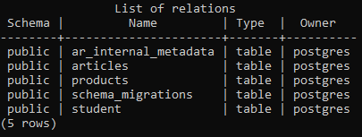
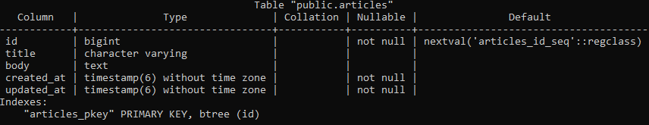
List of Tables
Table Preview

Slide 11
Inserting first record

Slide 12
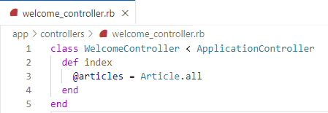
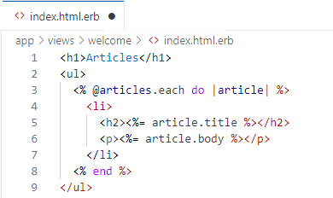
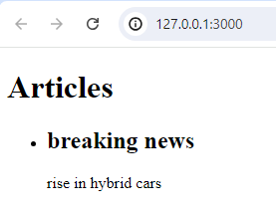
Fetch Data from Database
We can use any Model in any other Controller
Even we can use many Models in one Controller

Slide 13
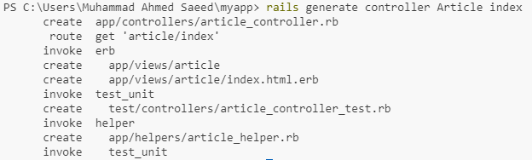
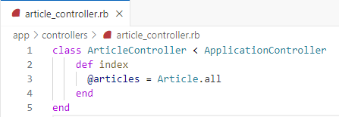
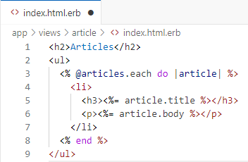
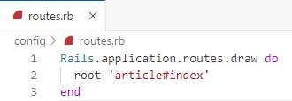
Create Model specific Controller
Best Practice

Slide 14
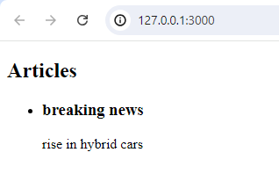
Preview

Slide 15


Slide 16

What is the purpose of a model in Ruby on Rails?
Which command is used to generate a model in Rails?
What file format is used to define model classes in Rails?
What is the primary purpose of a database migration in Rails?
Which command is used to create a new migration file in Rails?

Slide 17

Task 1
Make change in the existing Rails application by creating Model and adjust Controller and View accordingly, fetching and displaying data

